Slide 1
Class 4
China Shock
PubPol 201
Module 3: International Trade Policy

Slide 2
Class 4 Outline
China Shock
China’s growth
The China Shock
The ADH analysis
Other sources

Slide 3
Class 4 Outline
China Shock
China’s growth
The China Shock
The ADH analysis
Other sources

Slide 4
China’s Growth
Was China’s growth expected?
  Not by the Wall Street Journal, June 23, 1989
    Expected growth leaders:
      Bangladesh, Thailand, and Zimbabwe
    Expected laggard: China
      Due to “the stultifying bureaucracy of hard-line communism”

Slide 5
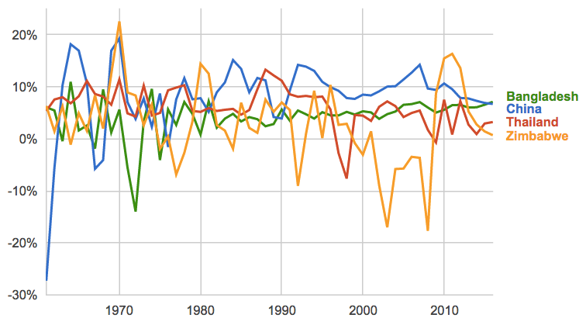
GDP Growth Rates
Source: World Bank
Notes:
https://www.google.com/publicdata/explore?ds=d5bncppjof8f9_&met_y=ny_gdp_mktp_kd_zg&idim=country:CHN:IND:USA&hl=en&dl=en#!ctype=l&strail=false&bcs=d&nselm=h&met_y=ny_gdp_mktp_kd_zg&scale_y=lin&ind_y=false&rdim=region&idim=country:CHN:THA:ZWE:BGD&ifdim=region&hl=en_US&dl=en&ind=false

Slide 6
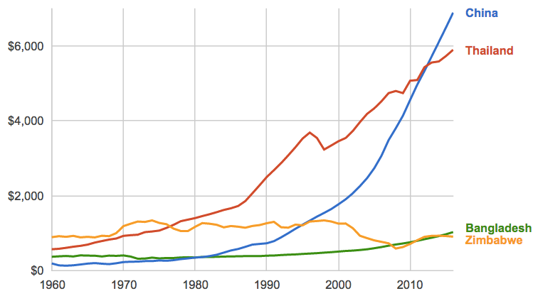
GDP per capita (Constant 2000$)
Source: World Bank

Slide 7
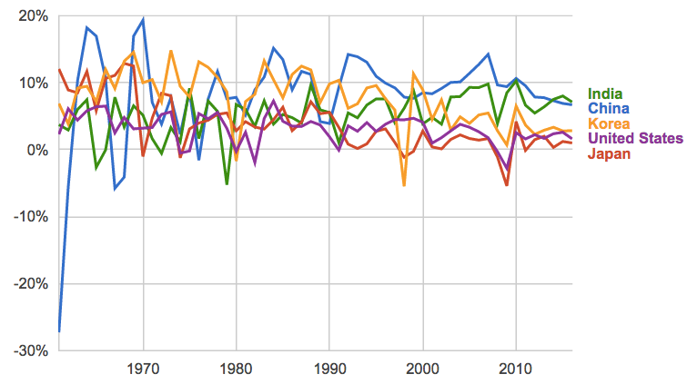
GDP Growth Rates
Source: World Bank

Slide 8
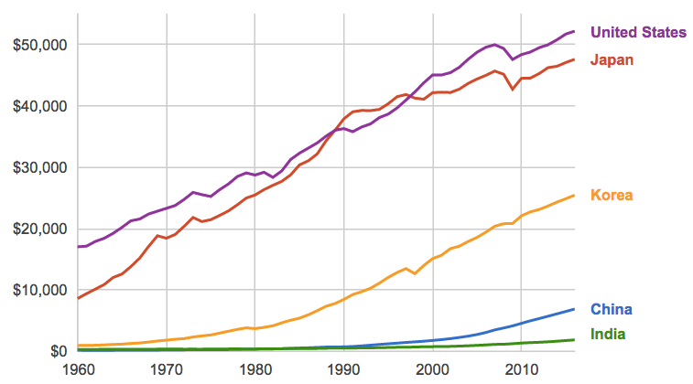
GDP per capita (Constant 2000$)
Source: World Bank

Slide 9
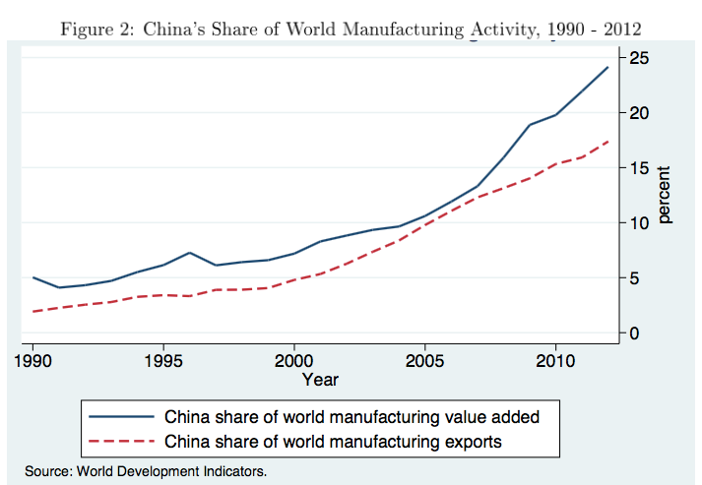
China’s WTO Entry

Slide 10
China’s Growth
Why China’s export growth accelerated after joining WTO in 2001
  Not because others reduced tariffs on Chinese exports
  They didn’t
  Instead they required China itself to lower tariffs and make other changes

Slide 11
China’s Growth
Why China’s export growth accelerated after joining WTO in 2001
  Privatization of some former SOEs (state-owned enterprises) more them efficient.
  Phased out restrictions that had inhibited exports.
  Lower Chinese tariffs gave industries cheaper imported inputs, making them more productive.
  Reduced uncertainty about foreign tariffs, unblocking investment.

Slide 12
Class 4 Outline
China Shock
China’s growth
The China Shock
The ADH analysis
Other sources

Slide 13
China Shock
Why study the China Shock?
  It’s important for its own sake
  Many think it is the cause of the large decline in US manufacturing
    But look at the data
    That decline started long before the China Shock

Slide 14
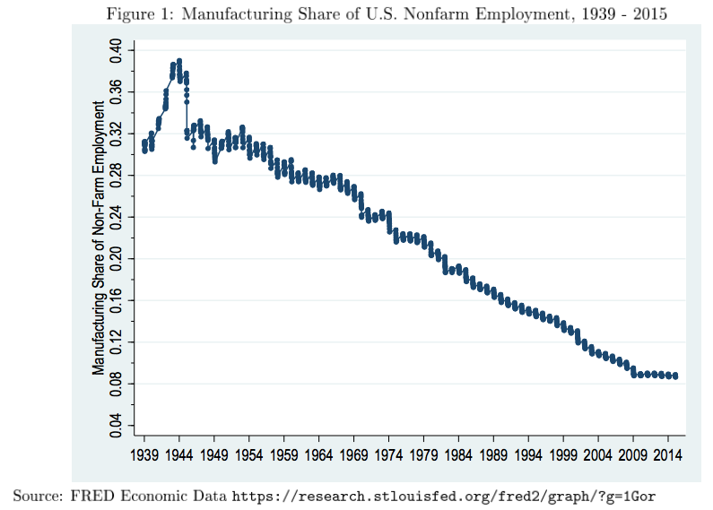

Slide 15
China Shock
Why study the China Shock?
  Also, it’s usually hard to find evidence of how trade affects an economy
    Changes in trade are usually
      Accompanied by many other changes
      Caused in part by the economies you want to study
    Thus causation is hard to figure out
    But the China Shock was plausibly a “natural experiment”
      A change in the real world similar to a controlled experiment

Slide 16
China Shock
Why study the China Shock?
  The China Shock was plausibly a “natural experiment”
    China’s growth, and the growth of its trade, were unexpected
    Its cause was largely the extreme isolation of China under Mao
    Its comparative advantage was distinctive: much of manufacturing but not primary products or resources

Slide 17
China Shock
Why study the China Shock?
  So the China Shock can give us information about how other changes in trade, including smaller ones, may affect an economy like the US

Slide 18
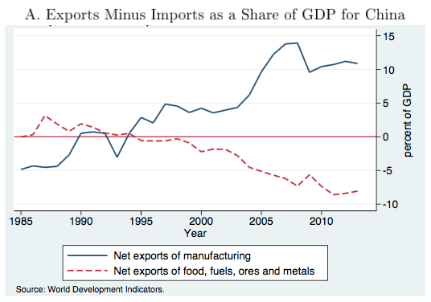
China’s WTO Entry

Slide 19
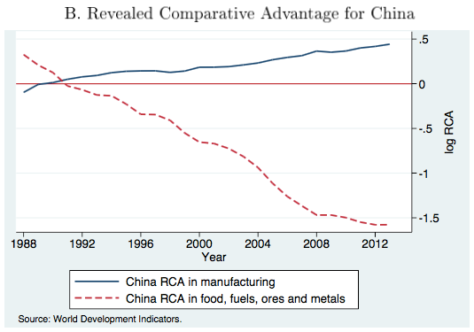
China’s WTO Entry
“Revealed comparative advantage” uses a formula to try to infer a country’s comparative advantage from data on its, and the world’s, trade.

Slide 20
China Shock
Nature of the China Shock
  China’s growth of exports to the US was broad
    Covering most of manufacturing
    Greatest in most labor-intensive sectors
    Varied in size across products within an industry
  The variation suggests that effects will differ across localities in US, which specialize in different products
  So the natural experiment differs across localities, giving multiple observations to study

Slide 21
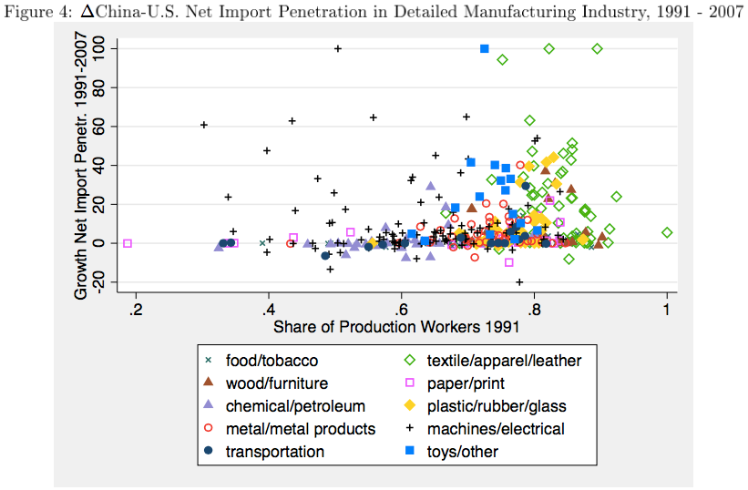
Measure of labor intensity

Slide 22
Discussion Question
The data show clearly that US imports from China rose at the same time that US manufacturing fell. Why is that, by itself, NOT enough to tell us that imports were harmful to the US?

Slide 23
Class 4 Outline
China Shock
China’s growth
The China Shock
The ADH analysis
Other sources

Slide 24
The ADH Analysis
The data show
  Simultaneous growth in
    China’s current account surplus
    US’s current account deficit

Slide 25
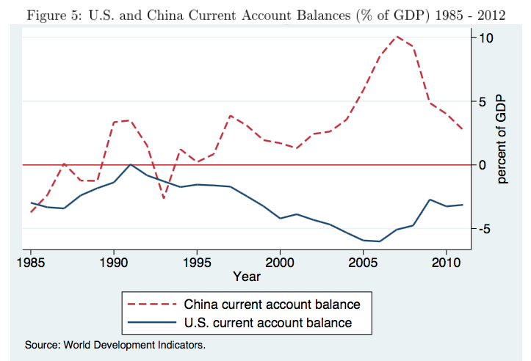
China’s WTO Entry

Slide 26
The ADH Analysis
The data show
  Simultaneous growth in
    China’s current account surplus
    US’s current account deficit
  That over the whole period 1991-2011, as well as sub-periods, across industries
    Imports from China grew
    Employment fell

Slide 27
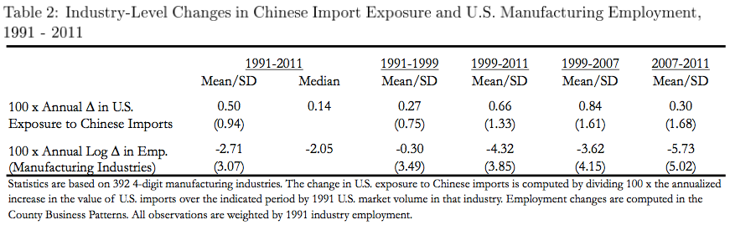
𝚫 = change
Log 𝚫 = change in the logarithm ≈ percent change
SD = standard deviation (measure of how different observations are)

Slide 28
The ADH Analysis
The data also show (from the standard deviations)
  That there was considerable variation across industries in both import penetration and employment loss
    This indicates that the data may reveal the relationship between them

Slide 29
The ADH Analysis
And they show that employment declined more in the later years:
  0.3 log points (≈ percentage) 1991-1999
  3.6 log points 1999-2007
  5.7 log point 2007-2011

Slide 31
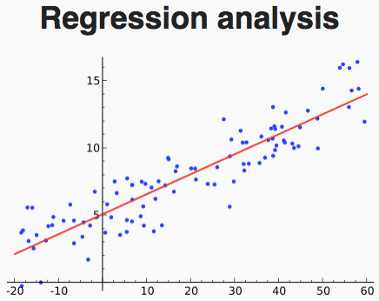
The ADH Analysis
Regression analysis
  ADH used standard statistical techniques to estimate the relationship between the two variables.

Slide 32
The ADH Analysis
Regression analysis
  ADH used standard statistical techniques to estimate the relationship between the two variables.
  Table 3 shows results for manufacturing only
    Col 1: OLS = Ordinary Least Squares
    Cols 2-3: 2SLS = Two-Stage Least Squares

Slide 33
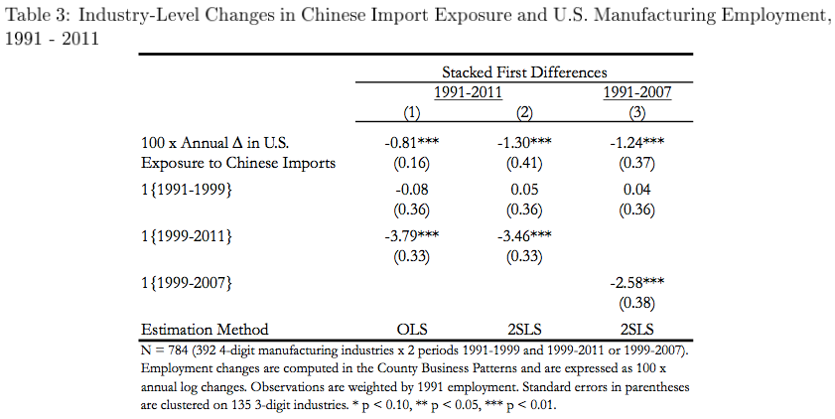
Estimated change in employment associated with a 1-percentage point rise in import penetration
“Dummy variables” for time periods: Ignore
Three stars mean probability that true effect is zero is less than 1%.
Thus highly “statistically significant”

Slide 34
The ADH Analysis
Why 2SLS?
  OLS results “could be biased because growth in import penetration is driven partly by domestic shocks.”
    ”Correlation is not causation”
  2SLS avoids this bias by using “instrumental variables”
    Here these are import penetration from China in countries other than the US

Slide 35
The ADH Analysis
Regression analysis
  ADH used standard statistical techniques to estimate the relationship between the two variables.
  Table 3 shows results for manufacturing only
    Col 1: OLS = Ordinary Least Squares
    Cols 2-3: 2SLS = Two-Stage Least Squares
  These can be used to plot in maps how parts of the US have been affected

Slide 36
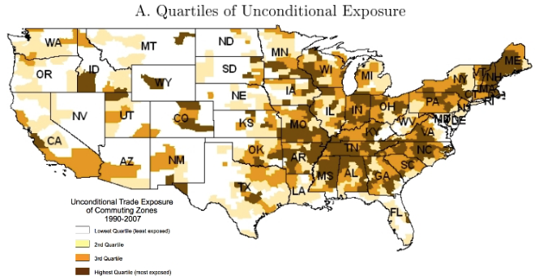

Slide 37
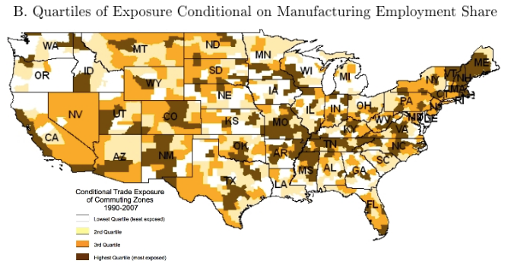

Slide 38
The ADH Analysis
Effects on other things
  Table 4A shows that import penetration causes
    Fall in employment in non-manufacturing
    Rise in unemployment
    Rise in “not in labor force”
  Table 4B show it also causes
    Fall in population
    Fall in wage
    Rise in transfers (from government)

Slide 39
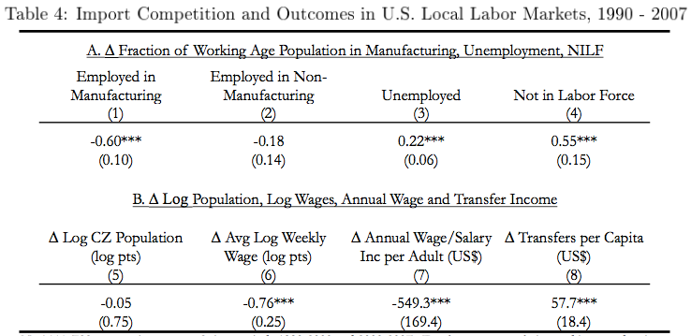

Slide 40
Discussion Question
Why would the China Shock cause each of these effects in localities with increased imports?
  Fall in employment in non-manufacturing
  Rise in unemployment
  Rise in “not in labor force”
  Fall in population
  Fall in wage
  Rise in transfers (from government)

Slide 41
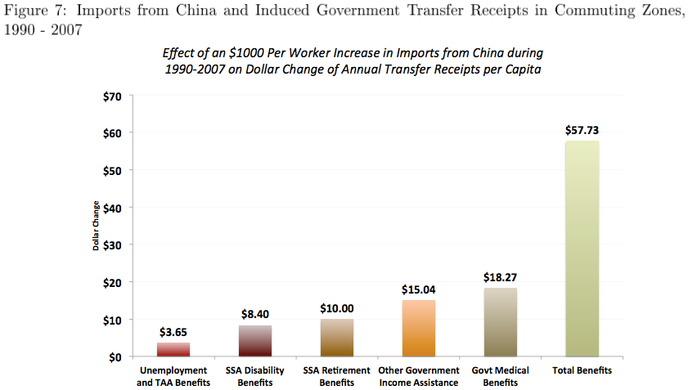
Note how small is the contribution of Trade Adjustment Assistance

Slide 42
The ADH Analysis
Persistence
  Another finding of ADH (I won’t show the graph) is that displaced workers tend either to remain in their same trade-impacted industry or move to another that is also vulnerable.
  “Labor-market adjustment to trade shocks is stunningly slow”

Slide 43
The ADH Analysis
The China Shock: ADH Concluding Comments
  “Employment has certainly fallen in U.S. industries more exposed to import competition.”
  “so too has overall employment in the local labor markets in which these industries were concentrated”
  “Offsetting employment gains … have, for the most part, failed to materialize.”
    I question this, though, since US unemployment is so low
  But: “The great China trade experiment may soon be over, if it is not already.”

Slide 44
Class 4 Outline
China Shock
China’s growth
The China Shock
The ADH analysis
Other sources

Slide 45
Other Sources
Arnold, in a reading from NPR, says
  “from 2000 to 2007, trade with China destroyed nearly 1 million U.S. manufacturing jobs.”
  But the graph there shows jobs falling by about 6 million. So China trade was only a small part of the drop.
  (Not really another source, since he’s quoting David Autor, the A of ADH.)

Slide 46
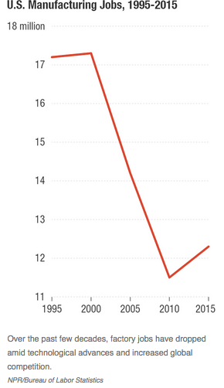

Slide 47
Other Sources
Davis & Hilsenrath:
  China was important even for jobs lost to Mexico: “Many U.S. factories that moved to Mexico did so to match prices from China.”
  “‘If we encouraged China to trade, we needed domestic policies in place that would minimize the impact that would follow.” We didn’t have those.
    Again not really a different source. This quotes Gordon Hanson, the H of ADH

Slide 48
Other Sources
Economist, “Economists Argue about the Impact of Chinese Imports on America”
  Work by Rothwell criticizes the results of ADH
    For using import data from Europe rather than the US
    For the timing of the ADH data
    For the way that the ADH results have been interpreted by the public, not recognizing that there were large consumer gains from the China Shock, as well as losses

Slide 49
Other Sources
Krugman
  Argues that it has not been trade itself that caused the costs observed by ADH, but rather its rapid rate of change
  This is relevant because a reversal of policy to reduce trade (by Trump?) would be equally damaging

Slide 50
Discussion Question
What should the United States have done differently with regard to trade with China?

